Slide 1

Mini Project (19AI701) – Review 1
PROCTORCAM - A DROWSINESS ALERTING SYSTEM
Submitted by:
SNEHA BASYAL M (212222240101)
AKSHAYAA M (212222230009)
LISIANA T (212222240053)
2022-2026 Batch
TEAM NO: 225
Under the guidance of:
Ms. SWEDHA V
Assistant Professor, Department of SCOFT
DEPARTMENT OF ARTIFICIAL INTELLIGENCE AND DATA SCIENCE
SAVEETHA ENGINEERING COLLEGE
(Autonomous Institution – UGC, Govt. of India)
(Affiliated to Anna University, Approved by AICTE - Accredited by NBA & NAAC – ‘A’ Grade - ISO 9001:2015 Certified)
Saveetha Nagar, Thandalam, Chennai-602 105, TamilNadu, INDIA.

Slide 2
Agenda
Abstract
Objectives
Introduction
Statement of the Problem
Purpose of your project
Existing System
Architecture Diagram
Proposed System
Literature review
Dataset Description
Project Plan/Tentative Chart
Conclusion
References

Slide 3
Abstract
The "ProctorCam-A Drowsiness Alerting System" addresses the growing need for maintaining alertness and focus during prolonged computer usage, especially in professional and educational settings. This system aims to detect and alert users when signs of drowsiness are detected, helping to prevent productivity loss and potential safety risks associated with fatigue. Utilizing advanced technologies such as OpenCV, TensorFlow, and Python, the system integrates Convolutional Neural Networks (CNNs) with Haar cascade classifiers, creating a robust hybrid approach to drowsiness detection. The Haar cascade classifiers quickly identify facial features and eye regions, while the CNN model performs detailed analysis to accurately determine the user's level of alertness by classifying eye states (open or closed). Upon detecting prolonged eye closure or other signs of drowsiness, the system triggers a sound alert through the PC's speakers, prompting the user to refocus and maintain productivity. This real-time feedback loop is crucial in environments where staying alert is essential, such as remote work, e-learning and in health conditions like sleep apnea, where maintaining alertness is vital.

Slide 4
Objectives
Real-Time Drowsiness Detection: Monitors facial expressions and eye movements to detect drowsiness through the webcam.
Sound Alert System: Triggers an audible alert through the PC’s speakers when drowsiness is detected.
Eye Tracking and Blink Rate Analysis: Utilize advanced image processing techniques and machine learning models (e.g., Haar Cascade Classifiers and CNNs) to track the user’s eyes, calculate the blink rate, and analyze eye closure duration to detect drowsiness.

Slide 5
Introduction
The "ProctorCam-A Drowsiness Alerting System" is designed to enhance alertness and productivity by detecting drowsiness and providing real-time feedback across various environments. It improves workplace safety and efficiency by preventing errors caused by fatigue, supports remote workers in maintaining focus during high-concentration tasks, aids individuals with sleep disorders or chronic fatigue by monitoring their alertness, and helps students stay engaged during long e-learning sessions. By addressing these diverse needs, the ProctorCam system aims to create safer, more productive, and focused environments.

Slide 6
Statement of the Problem
Maintaining alertness is increasingly difficult in work and study environments due to prolonged computer use, remote work, and extended study sessions. Drowsiness can lead to decreased productivity, safety risks, and health issues, particularly for individuals with sleep disorders or chronic fatigue. Current monitoring tools lack effective real-time drowsiness detection and feedback. The "ProctorCam-A Drowsiness Alerting System" addresses this gap by providing immediate alerts to enhance alertness and performance across various settings.

Slide 7
Purpose of the project
The "ProctorCam-A Drowsiness Alerting System" aims to boost user alertness and productivity by detecting signs of drowsiness and providing real-time feedback. In workplace environments, it enhances safety and efficiency by preventing errors caused by fatigue, particularly for employees who work long hours on computers. For remote workers engaged in tasks requiring intense focus, such as data analysis or content creation, the system helps maintain their concentration and quality of work. In health and wellness contexts, it supports individuals with sleep disorders or chronic fatigue by continuously monitoring alertness and alerting them to potential lapses. Additionally, in educational settings, especially e-learning platforms, it keeps students engaged and focused during extended study periods, improving their overall learning experience.

Slide 8
Existing System 1/3
Numerous existing systems have been developed to address drowsiness detection using various machine learning and computer vision techniques. One notable approach involves using machine learning models to detect sleep states, as demonstrated by Prakash et al. (2022), who implemented a PC-based sleep detection system leveraging advanced algorithms to enhance accuracy and reliability in real-time detection [1].
Driver drowsiness detection has also been a significant focus, with researchers such as Saranya et al. (2023) developing systems using the Haar Cascade Classifier to improve alertness in automotive environments [2]. Similarly, Gaikwad et al. (2023) explored driver assistance systems incorporating Haar-Cascade algorithms, emphasizing the need for reliable drowsiness detection during driving [3]. Another study by Suryawanshi and Agrawal (2020) utilized LBP and Haar algorithms to build robust driver monitoring systems [4].

Slide 9
Existing System 2/3
In addition, Vidushi Singhal et al. (2023) used DLib for facial landmark detection in drowsiness alert systems, highlighting the benefits of accurate facial feature tracking [5]. Automated proctoring systems, like the one developed by Maniar et al. (2021), showcase the use of computer vision for monitoring user behavior in examination settings [6]. Further, Negi et al. (2024) explored online proctoring using YOLO-v3 and MMOD CNN, demonstrating the applicability of these techniques in high-stakes environments [7].
Other research has focused on enhancing driver safety, such as Verma et al. (2023), who reviewed various algorithms for driver drowsiness detection, underscoring the critical nature of this technology in preventing accidents [8]. Early work by Dhawde et al. (2015) laid the foundation for drowsiness detection systems, examining the efficacy of simple machine learning models [9].

Slide 10
Existing System 3/3
Moreover, Peruda Jr. et al. (2022) developed an eye-blink detection system with smart locators, showcasing the versatility of Haar Cascade in different contexts [10]. A comprehensive review by Shaik (2023) consolidated various approaches to detecting and predicting drowsiness, providing insights into the state-of-the-art methodologies in the field [11]. Singh et al. (2022) further highlighted the application of machine learning techniques in developing effective drowsiness detection systems [12].
These existing systems provide a foundational understanding of how drowsiness detection can be applied across different domains, guiding the development of the "ProctorCam - A Drowsiness Alerting System." By leveraging insights from these works, the project aims to build a robust, real-time alert system tailored specifically for computer users in diverse environments, enhancing alertness and preventing the negative effects of drowsiness.

Slide 11
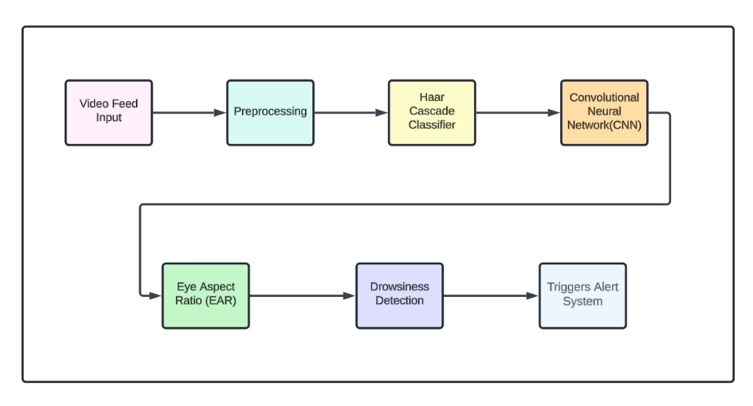
Architecture Diagram

Slide 12
Proposed System 1/7
Video Feed Input
The system starts with capturing live video from the user’s PC webcam. The video feed serves as the main input source for detecting facial and eye movements.
- Role in the Project:
It provides real-time visual data that is continuously analyzed to monitor the user’s face and eye behavior.
This step is crucial as it feeds the rest of the system with the necessary data to perform drowsiness detection.
Preprocessing
Preprocessing involves enhancing the quality of the captured video frames to make them suitable for further analysis. It includes several image processing techniques.

Slide 13
Proposed System 2/7
- Role in the Project:
Grayscale Conversion: Converts the color frames to grayscale, simplifying the image data and reducing computational load.
Noise Reduction: Applies filters to remove unnecessary noise, making the features like eyes and face more distinct.
Contrast Enhancement: Adjusts the image brightness and contrast, helping to highlight facial features under various lighting conditions. Resizing: Standardizes the frame size to ensure uniform input for detection algorithms, optimizing performance.
3. Haar Cascade Classifier
A machine learning-based approach that detects objects within the image, specifically trained to identify facial landmarks like the eyes and face.

Slide 14
Proposed System 3/7
- Role in the Project:
Detects the face and eyes within each frame, isolating the regions of interest for further processing.
It acts as the first level of detection to quickly and efficiently locate where the eyes are, setting up the following steps for more in-depth analysis.
4. Convolutional Neural Network (CNN) A deep learning model that performs advanced classification of the detected eye regions to determine whether they are open or closed.
- Role in the Project:
The CNN refines the eye state detection by analyzing subtle features that the Haar Cascade may miss, such as partial eye closures or varying shapes.

Slide 15
Proposed System 4/7
The CNN model is trained using a dataset of labeled eye images, containing both open and closed states, which helps the model learn to distinguish between different eye conditions accurately.
This training process allows the CNN to provide high accuracy in identifying drowsy eye states, even under challenging conditions like head tilts, glasses, or low lighting
5. Eye Aspect Ratio (EAR)
Calculation EAR is a mathematical calculation based on the distance between key landmarks around the eye to determine how open or closed the eyes are.
- Role in the Project:
It continuously measures the openness of the eyes by calculating the EAR for each frame.

Slide 16
Proposed System 5/7
A consistently low EAR indicates that the eyes are closing, which is used as an indicator of drowsiness.
6. Drowsiness Detection
This module uses the EAR values and the results from the CNN to detect drowsiness patterns over time
- Role in the Project:
It monitors the EAR over a set period and analyzes the consistency of eye closure.
If the EAR remains below a threshold for several consecutive frames, it confirms the user is drowsy.
This stage integrates all detection data to make an accurate decision regarding the user’s alertness state.

Slide 17
Proposed System 6/7
7. Triggers Alert System
When drowsiness is detected, the alert system is activated to notify the user immediately.
- Role in the Project:
Audible Alerts: Sounds an alarm or beep through the PC speakers to alert the user.
Visual Alerts: Displays warning messages on the screen, such as "You are drowsy!".

Slide 18
Proposed System 7/7
Conclusion:
Each step in the "ProctorCam - A Drowsiness Alerting System" plays a vital role in the accurate and efficient detection of drowsiness. From capturing the initial video feed to preprocessing and analyzing the data with machine learning models, the system is designed to provide a seamless and responsive alert mechanism. The combination of traditional image processing and advanced deep learning ensures that drowsiness is detected reliably, making ProctorCam an essential tool for maintaining focus during critical PC use.

Slide 19
Literature Review - Paper 1/12
SL NO | YEAR | AUTHORS | PAPER TITLE | PROBLEM STATEMENT | PROBLEM METHODOLOGIES | ADVANTAGES | DRAWBACKS | FUTURE SCOPE
1 | 2022 | V.R. Prakash, Deepak Borse, R Venkata Ramana, et al. | Sleep Detection for PC Using Machine Learning Model | Detection of a person’s fatigue through eye tracking and shutting down the PC when drowsiness is detected. | Real-time eye detection and tracking using the bright-pupil effect from IR light and object recognition techniques, with support vector machine and mean shift tracking | Works under variable lighting conditions, can detect drowsiness even when pupils are not bright due to external illumination interference. | The system can struggle with interference from significant external illumination. | Future application for detecting sleep in other electronics such as TVs and home appliances.

Slide 20
Literature Review - Paper 2/12
SL NO | YEAR | AUTHORS | PAPER TITLE | PROBLEM STATEMENT | PROBLEM METHODOLOGIES | ADVANTAGES | DRAWBACKS | FUTURE SCOPE
2 | 2023 | Dr. S. S. Saranya,Ravi Mytresh,Mylavarapu Manideep | An Improved Driver Drowsiness Detection using Haar Cascade Classifier | Driver fatigue and drowsiness are major contributors to traffic accidents, but current detection methods may not be accurate or timely. | Utilizes facial landmark detection with dlib and Haar Cascade classifier to track eye movements and measure the Eye Aspect Ratio (EAR) for drowsiness detection. EAR values are calculated for each frame to determine eye closure and blink patterns | Real-time facial landmark detection, fast processing time using Haar Cascade, integration with EAR-based detection for fatigue. Helps prevent accidents by alerting drowsy drivers and increases safety in commercial vehicles. | Reduced accuracy in certain lighting conditions, especially low light, and when obstructions like sunglasses or hats are present. Possible false alarms triggered by non-drowsy factors (e.g., looking away from the road). Does not account for other driver conditions such as yawning or heart rate, and complex algorithms may raise costs for full implementation. | Improvements could include additional factors like blink rate, yawning, and integrating sensors for monitoring heart rate to increase detection accuracy.

Slide 21
Literature Review - Paper 3/12
SL NO | YEAR | AUTHORS | PAPER TITLE | PROBLEM STATEMENT | PROBLEM METHODOLOGIES | ADVANTAGES | DRAWBACKS | FUTURE SCOPE
3 | 2023 | Sujata Gaikwad,Upendra Patil,Mansi Subhedar | Driver Assistance Systems with Driver Drowsiness Detection Using Haar-Cascade Algorithm | Fatigued driving is a serious traffic hazard, contributing to many accidents. Current detection systems have limitations, particularly with human reliance and detection accuracy. | A non-contact method that uses a camera to monitor the driver's face for drowsiness signs like yawning and eye closure. Raspberry Pi processes real-time data, using the Haar Cascade Algorithm for face and eye detection, with adaptive cruise control for safety. | The system is non-intrusive, can work with existing vehicles, and uses Raspberry Pi for cost-effective real-time processing. It improves safety with real-time drowsiness detection and alerts | The system may struggle with certain lighting conditions, reliance on the camera's angle, and memory issues when handling large video files. False positives may occur. | Potential for incorporating multi-channel color data processing, improving facial recognition under varied lighting, and integrating additional safety sensors such as heart rate monitoring.

Slide 22
Literature Review - Paper 4/12
SL NO | YEAR | AUTHORS | PAPER TITLE | PROBLEM STATEMENT | PROBLEM METHODOLOGIES | ADVANTAGES | DRAWBACKS | FUTURE SCOPE
4 | 2020 | Yuvraj Suryawanshi,Sushma Agrawal | Driver Drowsiness Detection System based on LBP and Haar Algorithm | Drowsiness is one of the leading causes of road accidents, contributing to 50% or more of traffic accidents. Preventing these accidents is critical. | The system uses Local Binary Pattern (LBP) for face detection and the Haar Cascade algorithm for eye detection. Eye blinking is monitored using AdaBoost with Haar Cascade for real-time drowsiness detection. The system raises an alarm when drowsiness is detected. | Real-time detection with high accuracy, low computational requirements, and no need for external hardware like Raspberry Pi. It captures facial and eye movements and alerts the driver to prevent accidents. | Limited to daylight conditions; it struggles in low-light or night-time environments. The system lacks advanced night vision capabilities and requires consistent brightness for accuracy. | Enhancements could focus on improving low-light performance, potentially by integrating infrared cameras or other sensors to improve detection accuracy during nighttime driving.

Slide 23
Literature Review - Paper 5/12
SL NO | YEAR | AUTHORS | PAPER TITLE | PROBLEM STATEMENT | PROBLEM METHODOLOGIES | ADVANTAGES | DRAWBACKS | FUTURE SCOPE
5 | 2023 | Vidushi Singhal, Nitasha Soni, Kanika Khatri, Bhavesh Kumar Chokkar, Krishan Kumar | Drowsiness Detection and Alert System using DLib | Detect driver drowsiness to reduce road accidents caused by fatigue | Uses computer vision with OpenCV and DLib to analyze facial features like eye closure and yawning. | Real-time detection and alert system with varying alert levels based on drowsiness severity. | Accuracy might be affected by external conditions like lighting; cannot handle all physiological signals effectively | Combine physiological signals with existing methods for more accurate detection; integrate with wearable devices to enhance alert accuracy.

Slide 24
Literature Review - Paper 6/12
SL NO | YEAR | AUTHORS | PAPER TITLE | PROBLEM STATEMENT | PROBLEM METHODOLOGIES | ADVANTAGES | DRAWBACKS | FUTURE SCOPE
6 | 2021 | Sarthak Maniar,Krish Sukhani,Krushna Shah,Sudhir Dhage | Automated Proctoring System using Computer Vision Techniques | Automated Proctoring System using Computer Vision Techniques | Uses computer vision techniques for eye gaze tracking, mouth open/close detection, object identification, etc. | Can detect multiple types of cheating and log activities; provides warnings before stopping the exam. | Requires good lighting and camera quality for accurate detection; high computational resources needed. | Replace YOLOv3 with faster models; integrate additional features like facial recognition and ID verification; develop multilingual speech-to-text capabilities.

Slide 25
Literature Review - Paper 7/12
SL NO | YEAR | AUTHORS | PAPER TITLE | PROBLEM STATEMENT | PROBLEM METHODOLOGIES | ADVANTAGES | DRAWBACKS | FUTURE SCOPE
7 | 2024 | Divyanshu Negi,Ambuj Bhandari,Abhishek Gaur,Abhishek Sindhwal,Rahul Chauhan,Akanksha Kapruwan | AI-based Online Proctoring System with YOLO-v3 & MMOD CNN | Address the limitations of manual proctoring during online exams. | Combines YOLOv3 for object detection with MMOD CNN for face detection; monitors multiple students simultaneously. | Efficient and scalable, can handle multiple students at once, reduces need for human proctors. | Requires high computational power; potential privacy concerns with continuous monitoring and recording. | Enhance system resilience to external disruptions like power failures; incorporate 360-degree monitoring for full room coverage; adapt to varied lighting and environments.

Slide 26
Literature Review - Paper 8/12
SL NO | YEAR | AUTHORS | PAPER TITLE | PROBLEM STATEMENT | PROBLEM METHODOLOGIES | ADVANTAGES | DRAWBACKS | FUTURE SCOPE
8 | 2023 | Harshit Verma, Amit Kumar, Gouri Shankar Mishra, Ujjwal deep, Pradeep Kumar Mishra, Parma Nand | Driver Drowsiness Detection | The issue of road accidents caused by driver drowsiness, leading to fatalities and injuries. | Use of a CNN-based machine learning system to detect driver drowsiness in real-time using webcam | Real-time monitoring, high accuracy, can prevent accidents, works offline. | May be impacted by lighting conditions, performance varies based on skin tone. | Integration with other safety features like lane departure warning and emergency braking. Can be used in commercial vehicles and autonomous driving systems.

Slide 27
Literature Review - Paper 9/12
SL NO | YEAR | AUTHORS | PAPER TITLE | PROBLEM STATEMENT | PROBLEM METHODOLOGIES | ADVANTAGES | DRAWBACKS | FUTURE SCOPE
9 | 2015 | Prashant Dhawde, Pankaj Nagare, Ketan Sadigale, Darshan Sawant, Prof. J. R. Mahajan | Drowsiness Detection System | Driver drowsiness is a major factor in vehicle accidents, leading to many deaths and injuries. Detecting drowsiness early can prevent accidents. | The system uses image processing to monitor the driver’s eyes in real time to detect signs of fatigue and issue a warning or slow down the vehicle. | Non-invasive, real-time monitoring with high accuracy and reliable drowsiness detection using image processing. | Limited to 80% accuracy and might have localization errors during real-time monitoring. | Refining the algorithm, testing under different road conditions, and integrating additional warning systems for better performance in real-world scenarios.

Slide 28
Literature Review - Paper 10/12
SL NO | YEAR | AUTHORS | PAPER TITLE | PROBLEM STATEMENT | PROBLEM METHODOLOGIES | ADVANTAGES | DRAWBACKS | FUTURE SCOPE
10 | 2022 | Sergio Peruda Jr.,Einstein Yong,Leonardo Samaniego Jr.,Stanley Glenn Bruca,John Maynard Heyasa,Paul Jan Armas,Jesto ni Tarun | Eye Blink Detection Alert System with Smart DRA Locator using Haar Cascade Algorithm | Road accidents due to driver fatigue and drowsiness are a major cause of death, necessitating systems to detect prolonged eye blinks that signal drowsiness. | The system uses Haar Cascade Algorithm for eye blink detection. It captures the driver's face and eyes, detects long blinks, issues an alert, and suggests the nearest Driver’s Rest Area (DRA). | High accuracy (96.67% in daylight and 90% at night), low cost, real-time alerts, and user-friendly mobile integration for rest area suggestions. | Reduced accuracy in low-light conditions and response time slower than the ideal (18.53 frames per second vs. 40 fps standard). | Use faster processors for improved response time, integrate mobile phone cameras, reduce environmental impact by using eco-friendly materials.

Slide 29
Literature Review - Paper 11/12
SL NO | YEAR | AUTHORS | PAPER TITLE | PROBLEM STATEMENT | PROBLEM METHODOLOGIES | ADVANTAGES | DRAWBACKS | FUTURE SCOPE
11 | 2023 | Md. Ebrahim Shaik | A Systematic Review on Detection and Prediction of Driver Drowsiness | Driver drowsiness is a significant cause of road accidents, leading to fatalities and severe injuries. Reliable detection and prediction systems are needed. | Various approaches analyzed: physiological, vehicle-based, subjective, and behavioral measures to detect drowsiness | Comprehensive analysis of multiple methods for detecting drowsiness, offering insights for future research. | Lack of a comprehensive understanding of driver behavior, especially under different driving conditions; many approaches are intrusive | Development of more non-intrusive, accurate drowsiness detection systems. Exploring machine learning and deep learning for real-time detection.

Slide 30
Literature Review - Paper 12/12
SL NO | YEAR | AUTHORS | PAPER TITLE | PROBLEM STATEMENT | PROBLEM METHODOLOGIES | ADVANTAGES | DRAWBACKS | FUTURE SCOPE
12 | 2022 | Jagbeer Singh, Ritika Kanojia, Rishika Singh, Rishita Bansal, Sakshi Bansa | Driver Drowsiness Detection System – An Approach By Machine Learning Application | Traffic accidents due to driver drowsiness, leading to numerous deaths and injuries. | Detects driver drowsiness by tracking facial features, especially eye blinking, using a camera. If eyes are closed for a certain time, an alarm alerts the driver. | Real-time detection with 80% accuracy. - Uses non-invasive methods (camera, OpenCV). | Reduced accuracy in poor lighting conditions. - Varies based on individual Eye Aspect Ratio (EAR). | Enhance accuracy in varying conditions (e.g., poor lighting). - Automatic threshold determination for EAR without needing individual settings.

Slide 31
Dataset Description 1/2
The Driver Drowsiness Dataset (size-3GB) is an extracted and cropped faces of drivers from the videos of the Real-Life Drowsiness Dataset. The frames were extracted from videos as images using VLC software. After that, the Viola-Jones algorithm has been used to extract the region of interest from captured images. The obtained dataset (DDD) has been used for training and testing CNN architecture for driver drowsiness detection in the “Detection and Prediction of Driver Drowsiness for the Prevention of Road Accidents Using Deep Neural Networks Techniques” paper.
To effectively train and evaluate the model, the dataset is splitted into two parts:
Training Set (80%): This portion contains 80% of the total dataset and is used to train the CNN models. The training data includes a wide variety of facial expressions and states (drowsy and non-drowsy) to ensure that the model learns the necessary features for drowsiness detection.

Slide 32
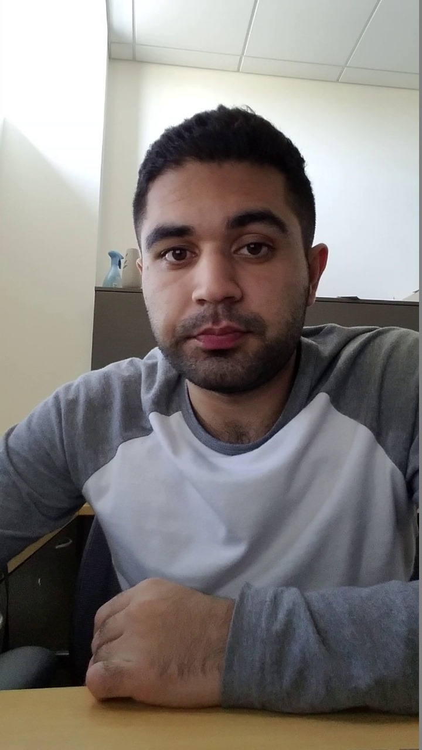

Dataset Description 2/2
Testing Set (20%): The remaining 20% of the dataset is set aside for testing. This unseen data is used to evaluate the model's performance after training, ensuring that it can generalize well to new, previously unseen examples.
LINK: https://www.kaggle.com/datasets/ismailnasri20/driver-drowsiness-dataset-ddd/data
SAMPLE IMAGES:
OPENED
CLOSED

Slide 33
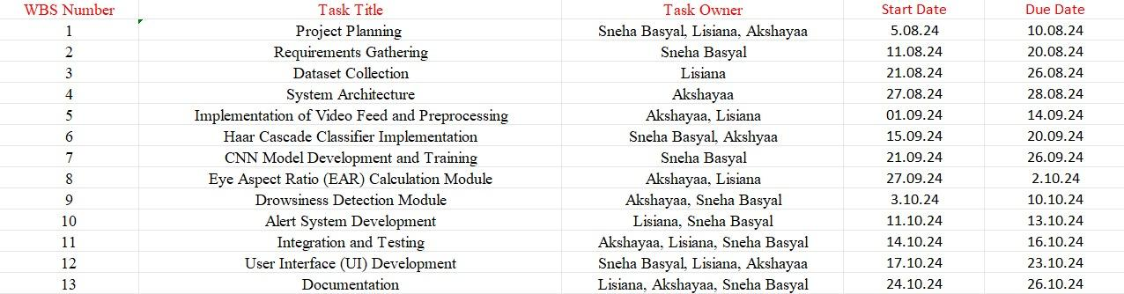
Project Plan/Tentative Chart

Slide 34
Conclusion
Protocam represents a significant step forward in the fight against fatigue-related accidents. By combining cutting-edge AI, machine learning, and computer vision, Protocam offers a reliable solution to detect and alert users to signs of drowsiness. Its real-time monitoring capabilities can significantly reduce the risk of accidents, making roads, workplaces, and other environments safer for everyone. As we continue to embrace technology in our daily lives, systems like Protocam are vital in ensuring that safety remains a top priority.

Slide 35
References 1/5
[1] V. R. Prakash, Deepak Borse, R Venkata Ramana, et al. Sleep detection for PC using machine learning model AIP Conference Proceedings 2452, 050002 - November 2022
[2]Dr. S. S. Saranya,Ravi Mytresh,Mylavarapu Manideep. An Improved Driver Drowsiness Detection using Haar Cascade Classifier. International Conference on Innovative Data Communication Technologies and Application (ICIDCA-2023)- August 2023
[3]Sujata Gaikwad,Upendra Patil,Mansi Subhedar.Driver Assistance Systems with Driver Drowsiness Detection Using Haar-Cascade Algorithm.2023 3rd International Conference on Advancement in Electronics & Communication Engineering (AECE)- April -2023
[4]Yuvraj Suryawanshi,Sushma Agrawal.Driver Drowsiness Detection System based on LBP and Haar Algorithm. International Conference on I-SMAC (IoT in Social, Mobile, Analytics and Cloud) (I-SMAC). -2020

Slide 36
References 2/5
[4]Yuvraj Suryawanshi,Sushma Agrawal.Driver Drowsiness Detection System based on LBP and Haar Algorithm. International Conference on I-SMAC (IoT in Social, Mobile, Analytics and Cloud) (I-SMAC). -2020
[5]Vidushi Singhal, Nitasha Soni, Kanika Khatri, Bhavesh Kumar Chokka.Drowsiness Detection and Alert System using DLib.2023 International Conference on Advances in Computation, Communication and Information Technology (ICAICCIT)- July-2023
[6]Sarthak Maniar,Krish Sukhani,Krushna Shah,Sudhir Dhage.Automated Proctoring System using Computer Vision Techniques.ISBN 978-1-6654-3986-2- February-2021

Slide 37
References 3/5
[7]Divyanshu Negi,Ambuj Bhandari,Abhishek Gaur,Abhishek Sindhwal,Rahul Chauhan,Akanksha Kapruwan.AI-based Online Proctoring System with YOLO-v3 & MMOD CNN.2024 IEEE 9th International Conference for Convergence in Technology (I2CT)- April-2024
[8]Harshit Verma, Amit Kumar, Gouri Shankar Mishra, Ujjwal deep, Pradeep Kumar Mishra, Parma Nand.Driver Drowsiness Detection.Journal of Data Acquisition and Processing · April 2023 [9] Prashant Dhawde, Pankaj Nagare, Ketan Sadigale, Darshan Sawant, Prof. J. R. Mahajan.Drowsiness Detection System.International Journal of Engineering Research & Technology (IJERT) ISSN: 2278-0181-2015

Slide 38
References 4/5
[9] Prashant Dhawde, Pankaj Nagare, Ketan Sadigale, Darshan Sawant, Prof. J. R. Mahajan.Drowsiness Detection System.International Journal of Engineering Research & Technology (IJERT) ISSN: 2278-0181-2015
[10]Sergio Peruda Jr.,Einstein Yong,Leonardo Samaniego Jr.,Stanley Glenn Bruca,John Maynard Heyasa,Paul Jan Armas,Jesto ni Tarun.Eye Blink Detection Alert System with Smart DRA Locator using Haar Cascade Algorith.h International Conference on Humanoid, Nanotechnology, Information Technology, Communication and Control, Environment, and Management (HNICEM)- February 2022

Slide 39
References 5/5
[11]Md. Ebrahim Shaik.A Systematic Review on Detection and Prediction of Driver Drowsiness.Transportation Research Interdisciplinary Perspectives 21 (2023) 100864 - June 2023
[12]Jagbeer Singh, Ritika Kanojia, Rishika Singh, Rishita Bansal, Sakshi Bansa.Driver Drowsiness Detection System – An Approach By Machine Learning Application.Journal of Pharmaceutical Negative Results. 2022

